Slide 1
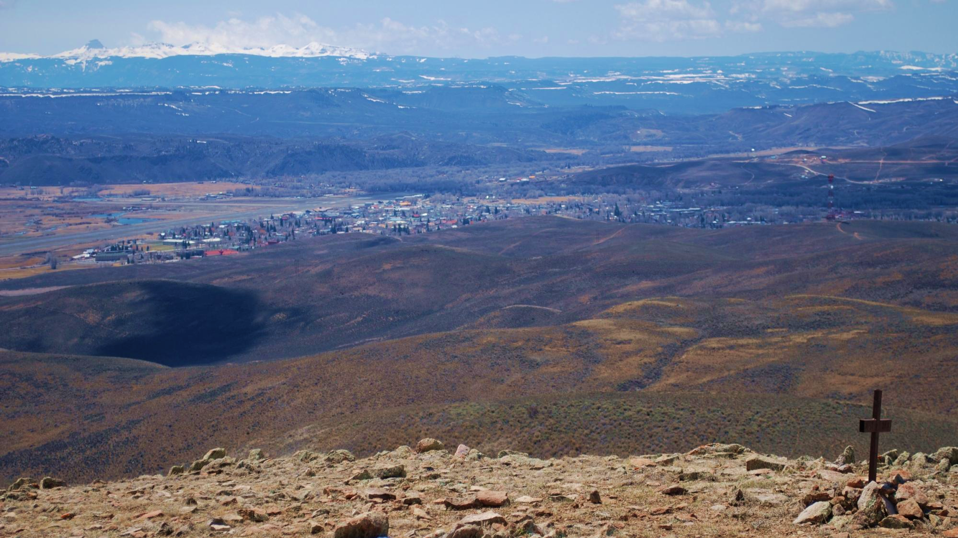
Gunnison Home Association
- Is there a logo for GHA?
Do we want a separate click on box for the Palisades Senior RV Park?
Do we want a click on box for reservations at the RV park on the home page?
- Do we want contact us at bottom of page or at left?
About Us
History
Board of Directors
Recent Projects
How to Apply for a Grant
Palisades Senior RV Park
Make a Donation
Contact Us

Slide 2
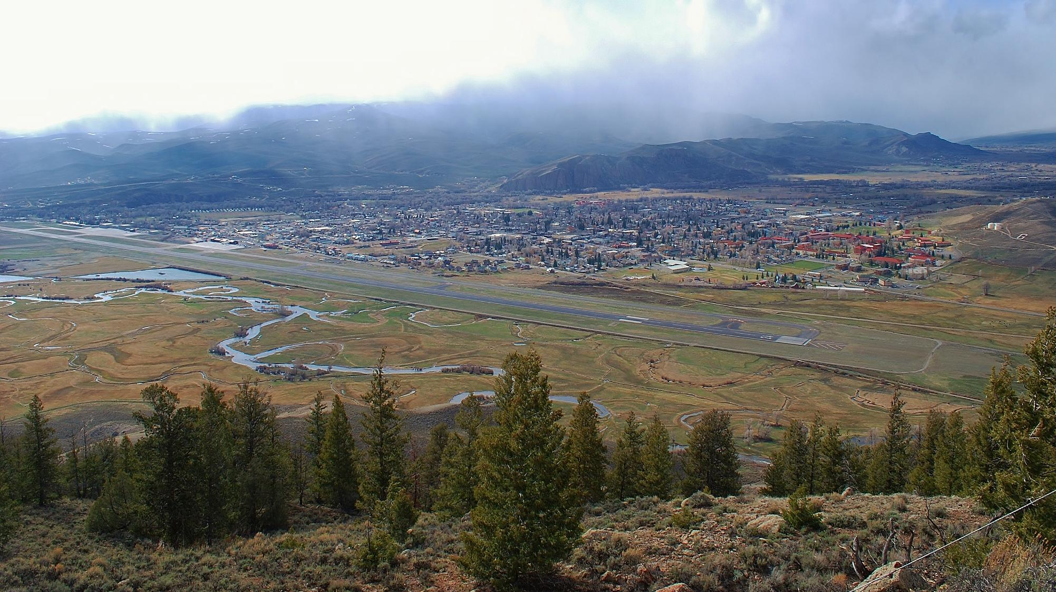
About the Gunnison Home Association
The Mission of the Gunnison Home Association (GHA) is to assist in the provision of basic needs and amenities to seniors in the Gunnison Valley. These services may include housing, food assistance, transportation, medical needs or social and cultural enrichment. It is our goal through our activities and grant program to provide financial assistance to be used to enhance the lives of senior citizens in our area, whether full-time or seasonal residents.
The GHA is a 501 © (3) non-profit corporation/organization for the charitable purpose of supporting long term care and many other senior services.

Slide 3
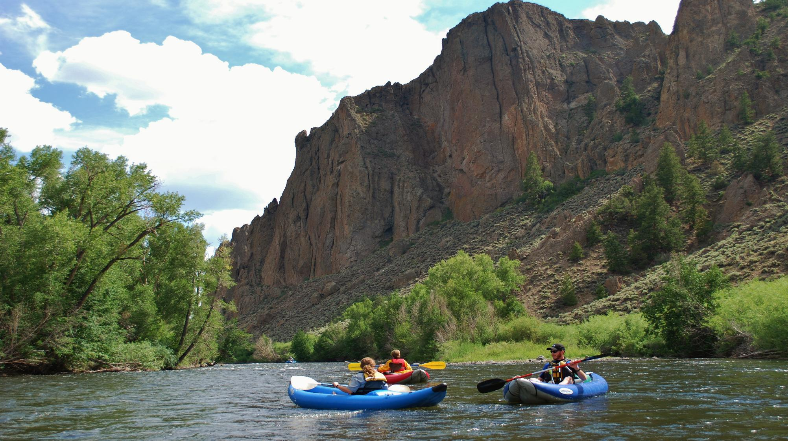
History of the GHA
In 1972-73 long-time resident Ben Jorgensen, recognized the need for special facilities for seniors. He donated 17 acres of land in West Gunnison to the City of Gunnison near the Gunnison River and a spectacular volcanic rock formation known as the Palisades. The land was to be perpetually reserved for the exclusive use as a site for construction and operation of a long-term care facility and appurtenant dwelling units for the elderly. The Gunnison City Council appointed a five-member committee to pursue the vision.
By 1976 four local banks, the GHA Board and hundreds of individuals and groups raised the funds needed to complete the facility and it received its first occupants by that fall. Over the years three separate expansions were completed: the Iva Lehman Solarium; a workshop and storage facility in memory of Clarence Lehman, and a 4,200 sq. ft. addition and major remodeling of space in the original building.
In 1995 the GHA transferred ownership of the Health Care Facility and six acres of land to Gunnison County, who now operates the facilities under the same authority as it operates the Gunnison Valley Hospital and Public Health Services.
By 2000 the Willows Assisted Living Center was built and managed by the GHA through 2007. At that time the facility was transferred to the County and became a part of Gunnison Valley Health.

Slide 4
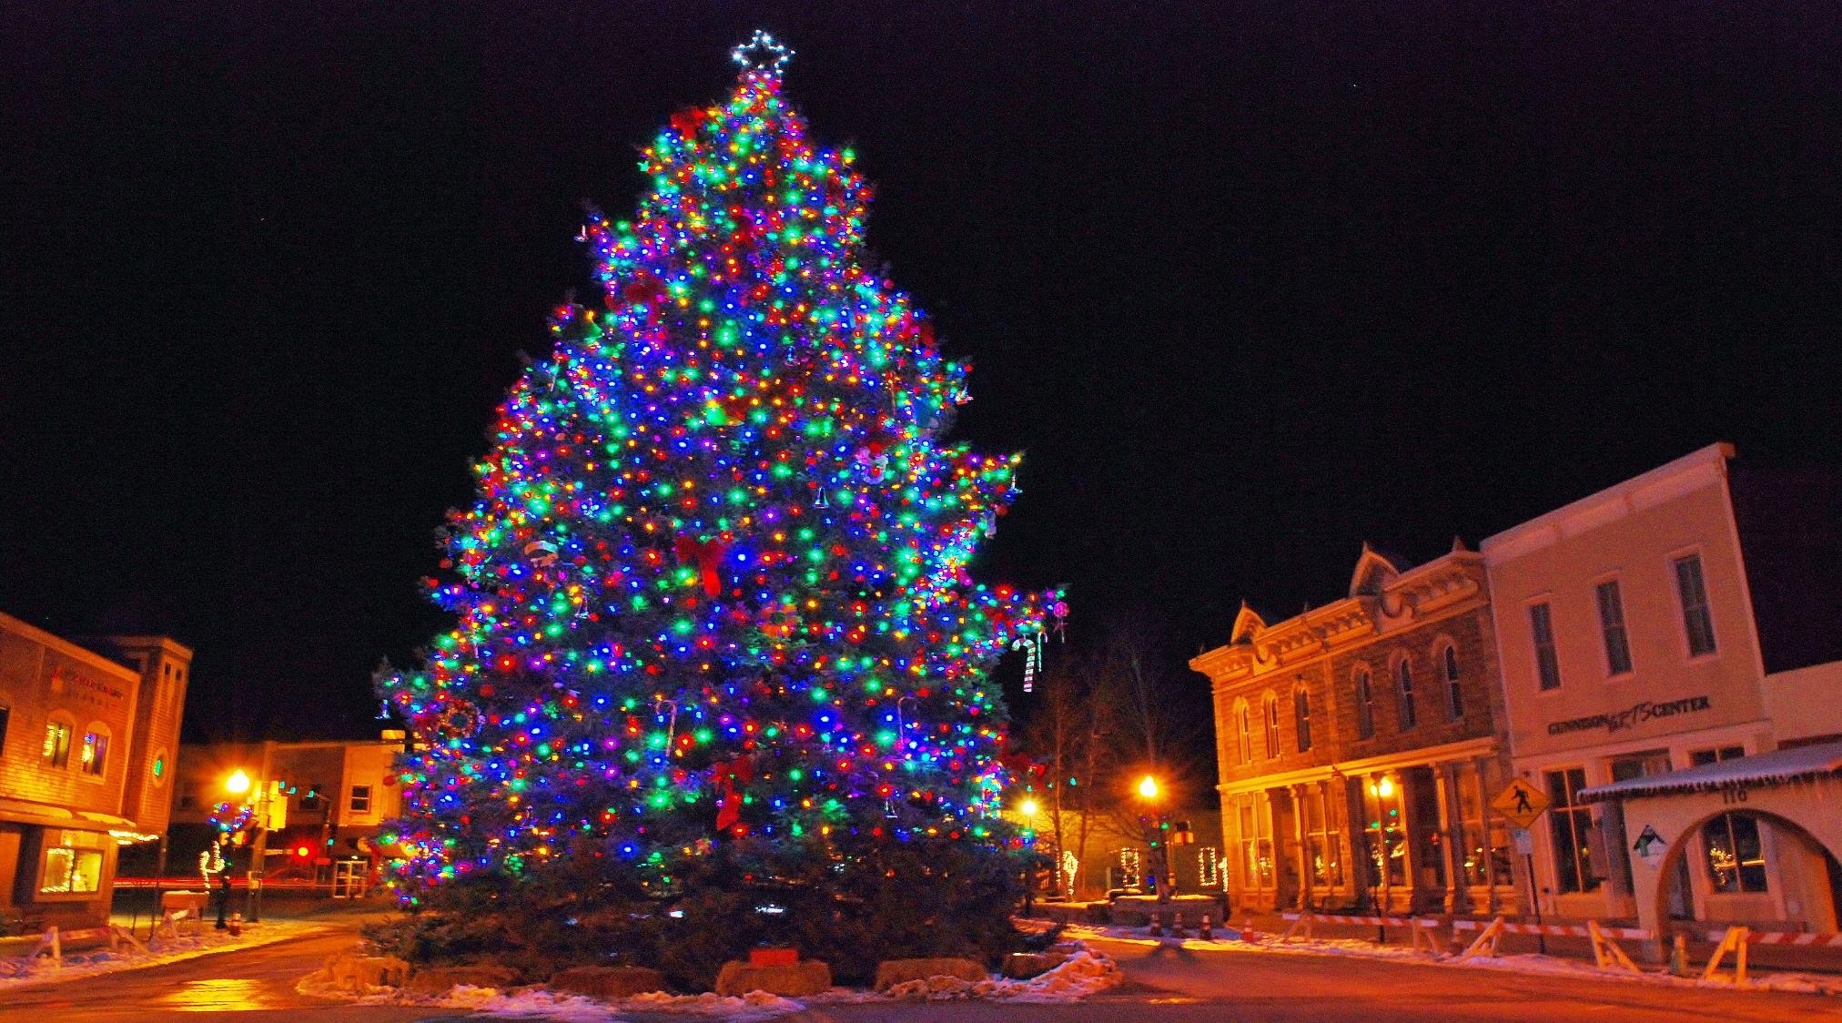
History – Past Projects
In 2007 the GHA with in-kind assistance from Gunnison County built the Palisades Senior RV Park providing 60 summer recreational vehicle sites for Seniors. Improvements since construction include an extended covered patio, garage, gazebo and two dog parks.
Over the years the GHA has contributed several hundred thousand dollars for numerous projects/entities including: senior transportation, the Gunnison Food Pantry, the Boomers senior group, the senior wing at the Gunnison Recreation Center, the Volunteer Fire Department, handicap accessible independent living units, Hospice and Palliative Care, senior meals program, Mountain Roots, Gunnison Valley Animal Welfare League, the public library, Six Points and the Gunnison Arts Center to name a few.

Slide 5
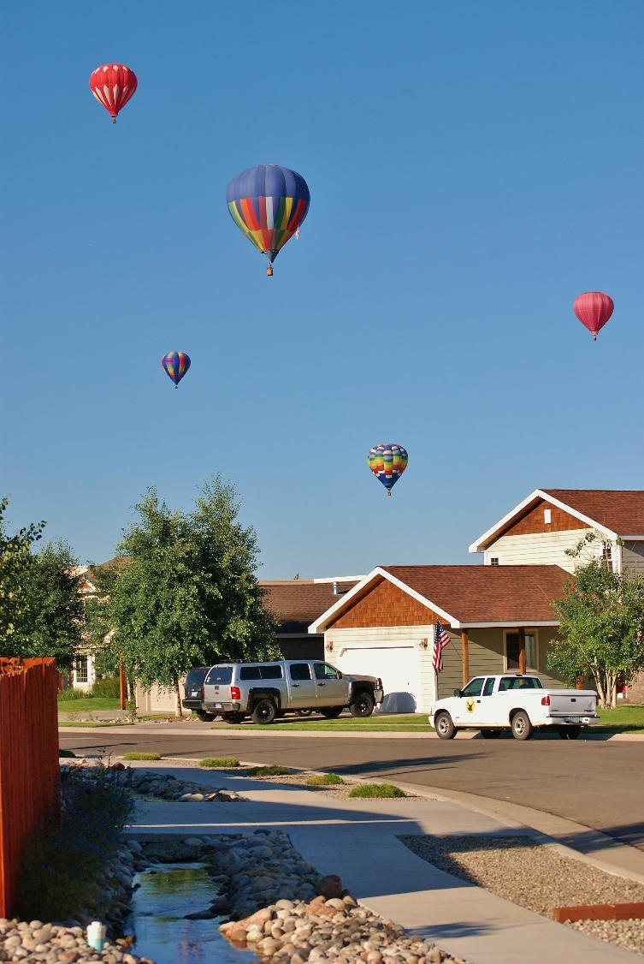
Board of Directors
Current Board members include:
Don Crosby – President
Rogene McKienan
Debbie McVey
Sharon Mills
Poly Oberossler
Linda Rees
Stuart Schneider

Slide 6
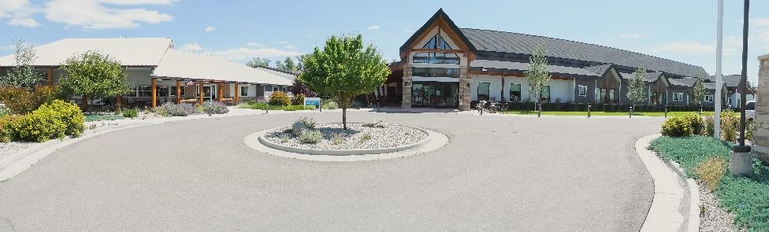
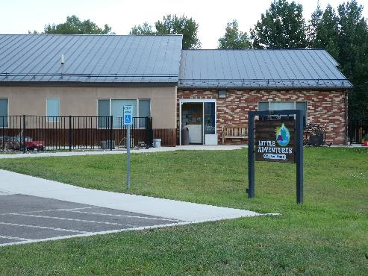
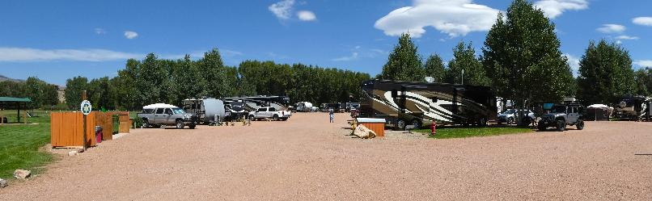
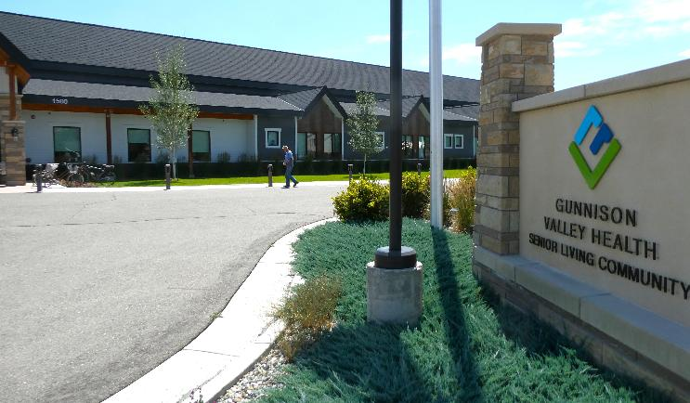
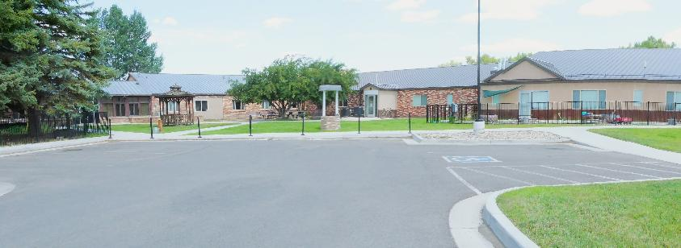
Past projects
Include captions w/ title & date

Slide 7
Recent Projects

Slide 8
Previous Grants
List 3-5 grants

Slide 9
Request a Grant
Include Instructions Page
Grant Guidelines
Include Application Form (fillable?)

Slide 10
Make a Donation

Slide 11
Contact Us
Include Address/PO Box
Include email
Include phone #s if applicable

Slide 12
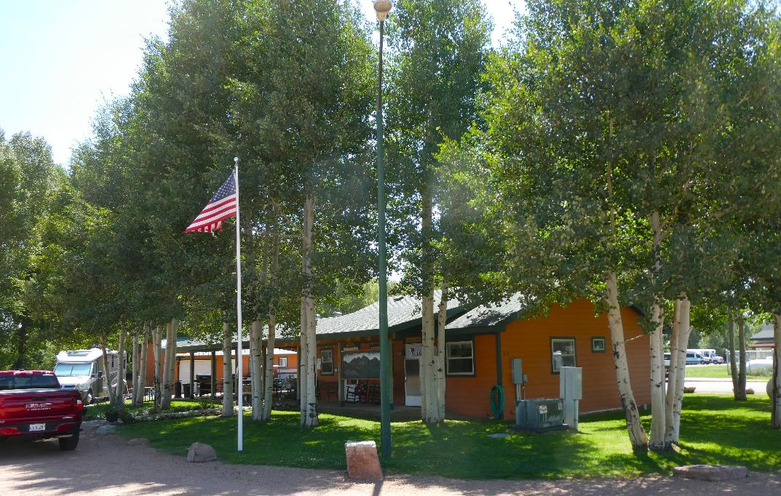
Palisades Senior RV Park
Adult RV Park 55 and up
60 full-service public campsites for rent daily, weekly or monthly
470 North Third Street Gunnison, CO 81230
(970) 641-4951
palisadesrv_55@tyahoo.com
www.gunnisonchamber.com
Activities include:
Quiet relaxing location
Weekend BBQs
Mid-week Happy Hours with local speakers
Backcountry Rod Trips
Board games, cards, sewing
Morning RC Airplane flights

Slide 13
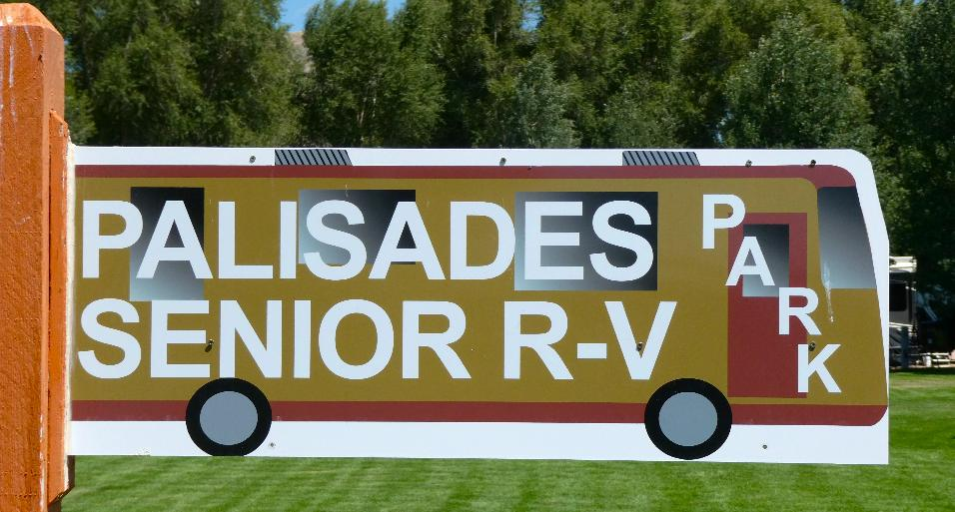
Palisades Senior RV Park Pages
Overview Page - purpose
Brief Description of RV park - amenities
Contact Address & phone number(s)
City Map with location
Map with numbered sites
Season of Use/dates
Park Guidelines (rules)
On-site & Nearby Activities
Gunnison Valley Local Attractions
Links to other sites (Senior Center; Chamber of Commerce/VC; Parks & Recreation; etc.
Volunteer Opportunities
Current RV Park Staff
Photos

Slide 14
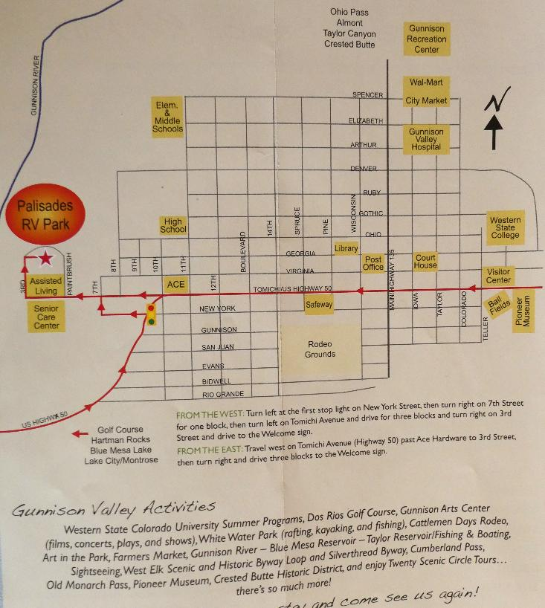
Map of Gunnison

Slide 15
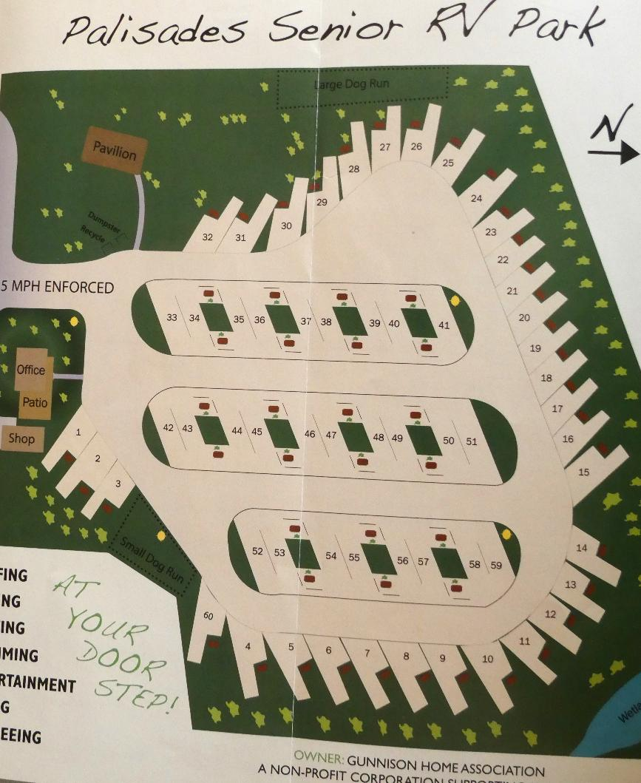
RV Park Map

Slide 16
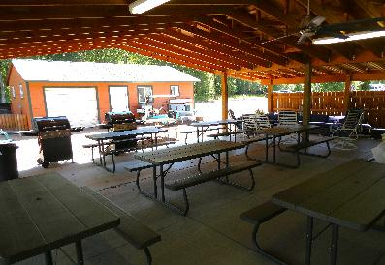
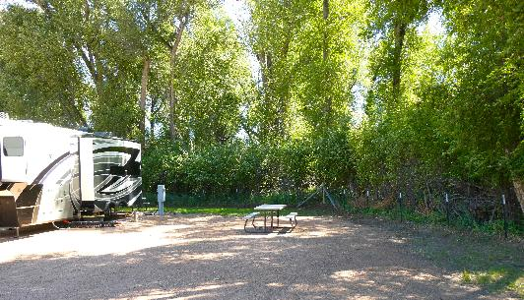
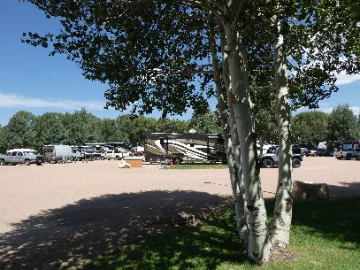
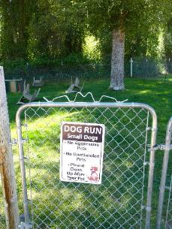
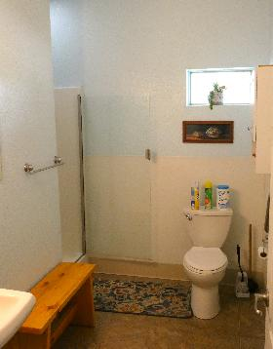
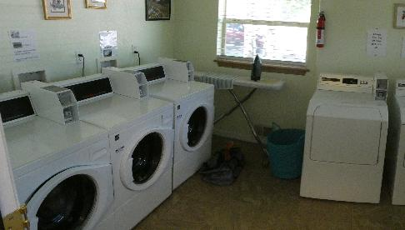
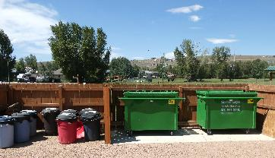
Site Provisions
Site Provisions
27 pull-through sites
33 back-in sites
50 Amp service
City utilities
Laundry room
Handicapped accessible restroom and showers
Wi Fi internet
Quiet hours enforced
Covered recreation area
Walk to the river & park
Weekly on-site activities
Grass dog runs
RC airplane group
Biking and walking trails
5 mph speed limit

Slide 17
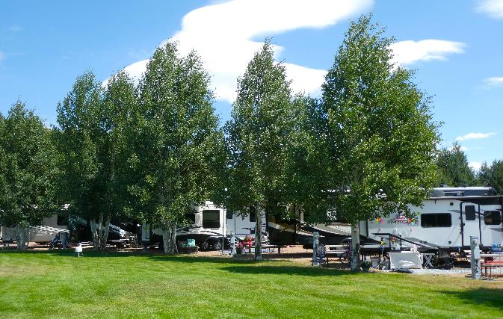
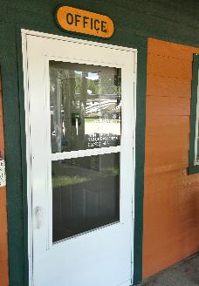
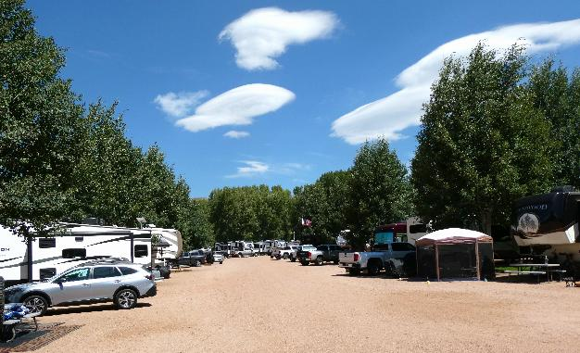
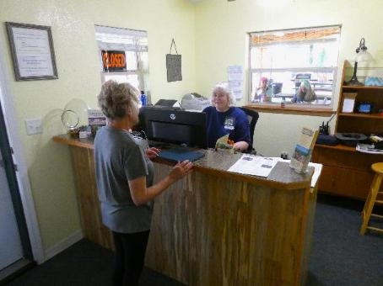
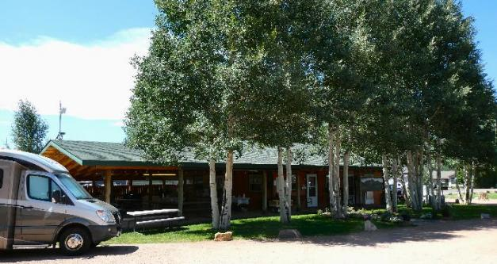
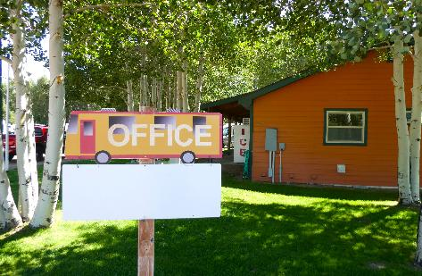
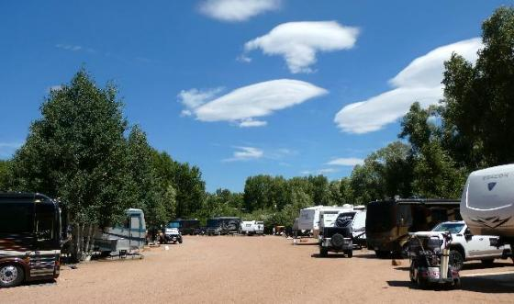
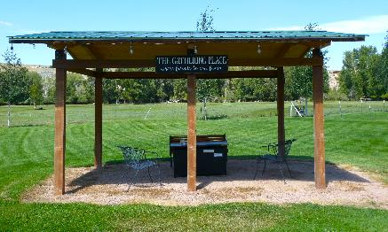
RV Park Photos

